Slide 1
Oligopoly and Strategic Behavior
13
Notes:
Pre-class music: “Diamonds from Sierra Leone” by Kanye West (Featuring Jay-Z) (See Tip #445)
This song introduces the black market, as well as supply and demand and the costs of labor.

Slide 2
Economics in A Beautiful Mind
Game theory
Notes:
“Economics in the Media” Slide:
Lecture tip:
The clip mentioned on the slide can be found in the Interactive Instructor’s Guide. Access the direct link by clicking the icon in the PowerPoint above.
Instead of playing pre-class music, you could show the bar scene from A Beautiful Mind. The clip provides a nice introduction to game theory, and a later slide models it as a game, showing that Nash’s solution in the movie is not a Nash equilibrium.
Recall the conditions necessary for a firm to be able to price discriminate:
Market power—price maker
Ability to separate consumers based on willingness to pay
Have to be able to prevent resale

Slide 3
Previously
Monopolistic competition:
  A market with many firms, differentiated products, and free entry and exit
Firms earn zero economic profits in the long run but produce with excess capacity.
There is a tradeoff between variety and inefficiency.
Firms advertise in order to increase demand for their product, but the effects may offset.
Notes:
Lecture notes:
For differentiated products, think about different brand names (cereals, snacks, candy bars, fast-food restaurants, etc.).
Remind students that there is inefficiency since P > MC, and firms produce with excess capacity.
But consumers gain since they can buy products that better match their tastes.

Slide 4
Big Questions
What is oligopoly?
How does game theory explain strategic behavior?
How do government policies affect oligopoly behavior?
What are network externalities?

Slide 5
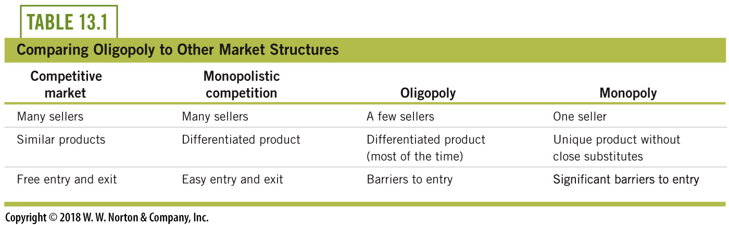
What Is Oligopoly?
vv
vv
vv
Notes:
Lecture tip:
Click through the slide to reveal the items in the “Oligopoly” column of the table.
Remind students of the three market structures you have covered so far.
Ask students to fill in the blanks under the Oligopoly column. Click through the slide to make each item appear in that column.
First–third clicks complete the table.
On few sellers, point out that it is a few “large” sellers. There could be a competitive fringe—large number of smaller firms.
Oligopoly would be closer to monopoly than to perfect competition.
Both have significant barriers to entry so you can earn economic profit in the long run.
Both will have market power: oligopoly less than monopoly but more than monopolistic competition.
Differentiated products:
Automobiles and beer vs. steel and copper
A key feature of oligopoly is that there is mutual interdependence or strategic interaction.
When a firm is deciding on some action (change price, output, develop new product, advertise), it must consider what its rival will do in response.
Note that this conduct is absent in the other markets since either there is only one firm or many.

Slide 6
Measuring Concentrations of Industries—1
Concentration ratio:
  Sales of the largest four firms as a percentage of total industry sales
  A measure of oligopoly power in an industry
Notes:
Lecture notes:
Intuition:
We’re asking how concentrated the industry is (concentrated within a few firms, or more spread out?)
Typically look at the four firm concentration ratio:
We could also look at eight.

Slide 7
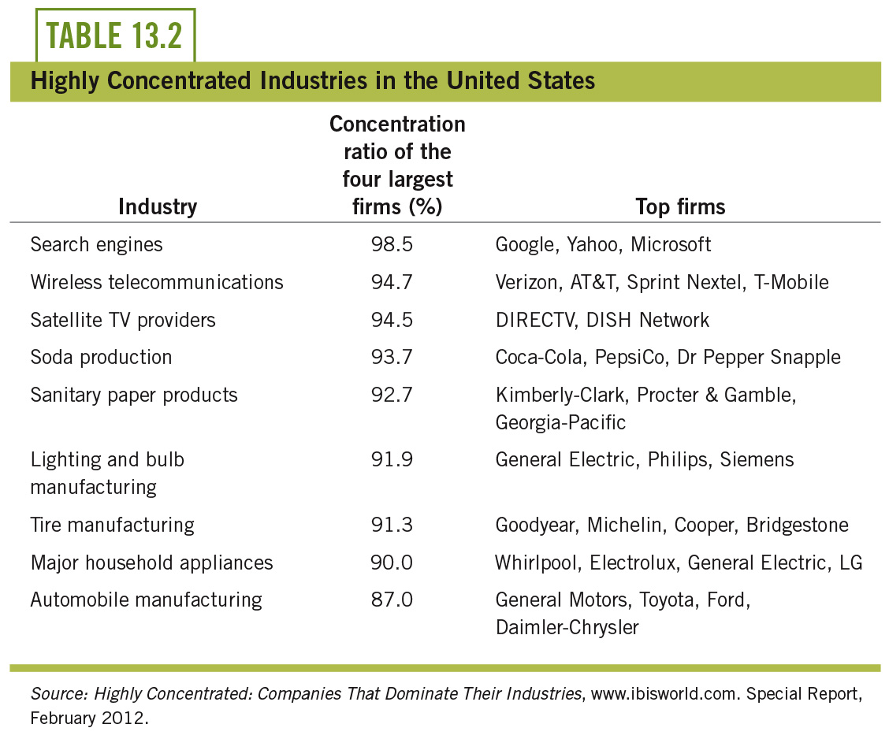
CR(4)s in the United States
Notes:
Lecture notes:
Top of the table:
Very concentrated industries
Top four firms make up almost entire industry
Search engines and satellite TV providers are true oligopolies!
Bottom of the table:
Still concentrated, but there are more “fringe” competitors in the household appliance and automobile industries

Slide 8
Measuring Concentrations of Industries
Concentration ratio:
  Sales of the largest four firms as a percentage of total industry sales
  A measure oligopoly power in an industry
  Higher concentration → greater market power
  But concentration is a rough measure of market power.
Notes:
Lecture notes:
On the link between concentration and market power:
Concentration-collusion hypothesis: it’s easier for firms to collude if there are a small number of them.
Could extend this to the smaller the number of firms, the more likely you are to observe non-competitive behavior.
On rough measure:
The text mentions the effect of international competition constraining domestic firms’ market power.
Two industries:
Industry A: four firms with 25 percent each
Industry B: one firm with 70 percent; three firms with 10 percent each.
Ask students in which industry they would expect firm(s) to possess significant market power.

Slide 9
Collusion and Cartels—1
Conflict in an oligopoly
  Firms would like to collude or join a cartel, and jointly act as a monopoly.
  But, collusion tends to be unstable.
    Why?
  So competition between firms drives price down below the monopoly price.
Notes:
Lecture tip:
Here are some of the ideas that we want to develop within the next few lectures:
Collusion: Agreement among rivals specifying prices or quantities
Cartel: Two or more firms acting in unison to form a joint monopoly
The storyline: Why is collusion unstable?
Firms in a duopoly realize that a cartelized monopoly is more profitable than a duopoly.
Firms shake hands, agree to become a cartel, and restrict output.
Each individual firm in the cartel says, “Wait a minute . . . if they all restrict their output, price goes up. I should produce more!” At least one firm may eventually “cheat” and break the cartel deal.
The cartel falls apart, no one trusts each other, and the firms go back to duopoly competition.

Slide 10
Collusion and Cartels—2
A simple example:
  Two cell phone carriers in a small town: Horizon and AT-Phone
  Each firm has excess capacity, so marginal cost of additional customer is zero
  Want to see how the outcome under duopoly compares to the competitive and monopoly outcome
Notes:
Lecture tip:
The text sets up the example that is used for the next eight slides.
Note to instructors:
If you teach industrial organization, you may think at this point that the textbook is going to discuss some form of Bertrand competition. Although it is not explicitly stated, the example the book develops is really Cournot competition.

Slide 11
Cell Phone Market—1
Price/Month (P) | Number of Customers (Q) | Total Revenue (TR) TR = P × Q
$180 | 0 | $0
165 | 100 | 16,500
150 | 200 | 30,000
135 | 300 | 40,500
120 | 400 | 48,000
105 | 500 | 52,500
90 | 600 | 54,000
75 | 700 | 52,500
60 | 800 | 48,000
45 | 900 | 40,500
30 | 1,000 | 30,000
15 | 1,100 | 16,500
0 | 1,200 | 0
Monopoly Outcome
Competitive Outcome
Notes:
Lecture notes:
The table shows the demand schedule for cell phone service.
Ask students what would happen if the market was perfectly competitive.
Remind them that marginal cost is equal to zero.
First click:
P = MC = 0, Q = 1,200
Remind them that this is socially efficient.
Ask students what would happen if the market was a monopoly.
Since MC = 0, look for the point where TR is maximized.
Second click:
P = $90, Q = 600

Slide 12
Cell Phone Market—2
Duopoly outcome:
  What do Horizon and AT-Phone do if they collude (form a cartel)?
Price/Month (P) | Number of Customers (Q) | Total Revenue TR = P × Q
90 | 600 | 54,000
75 | 700 | 52,500
60 | 800 | 48,000
45 | 900 | 40,500
30 | 1,000 | 30,000
15 | 1,100 | 16,500
0 | 1,200 | 0
Cartel Outcome
Notes:
Lecture notes:
Point out to students that the top half of the table is not necessary since the duopoly solution would be between the monopoly solution and the competitive solution.
The two firms will jointly act like a monopoly.
First click:
Set P = $90
Each will serve 300 customers.
Each will share the monopoly profits: $27,000 each.

Slide 13
Cell Phone Market—3
Duopoly outcome:
  Why is this outcome likely to fail?
Price/Month (P) | Number of Customers (Q) | Total Revenue TR = P × Q
90 | 600 | 54,000
75 | 700 | 52,500
60 | 800 | 48,000
45 | 900 | 40,500
30 | 1,000 | 30,000
15 | 1,100 | 16,500
0 | 1,200 | 0
Cartel Outcome
Notes:
Lecture notes:
Collusive outcome fails because:
If AT-Phone believes that Horizon will maintain the agreement, they will want to cut prices in order to be able to serve more customers.
But if AT-Phone cuts their price, Horizon would want to cut their price as well, to maintain their market share.
So what price will each firm set? How many customers will they serve?
The next slide explains mutual interdependence and a Nash equilibrium.
Lecture tip:
The order of the slides deviates a little from the textbook. In the book, they first find the Nash equilibrium, then define mutual interdependence, and then define a Nash equilibrium. It’s also not clear in the book whether firms are choosing prices or output: (i.e., Bertrand competition or Cournot competition). The next few slides will do both. A later slide models the problem as a game with a payoff matrix to illustrate the problem a different way.

Slide 14
Mutual Interdependence
Mutual interdependence
  A market situation in which the actions of one firm have an impact on the price and output of its competitors.
  AT-Phone’s response depends on the actions of Horizon, and Horizon’s response depends on the actions of AT-Phone.
  Note the difference between interdependence and independence.
Notes:
Lecture notes:
Interdependence:
Occurs in oligopoly due to the size of each individual firm
When one firm owns a sizable share of the market, the decisions made by that one firm affect the market in a noticeable way and therefore affect the decisions of competing firms.
Independence:
Occurs in perfect competition
If each firm is just a “drop in the bucket” compared to the size of the industry, one competitor’s actions will have no noticeable effect on the market, and thus firms will choose actions independently of other firms.

Slide 15
Nash Equilibrium
Each decision maker is choosing the best response to what the other decision maker has chosen.
In a Nash equilibrium, all economic decision makers opt to keep the status quo.
This means that there is no incentive for either decision maker to change what he or she is doing.
Notes:
Lecture notes:
In oligopoly, the process that leads to equilibrium may take on a special form referred to as a Nash equilibrium.
Named after the 1994 Nobel Prize winner, John Nash.

Slide 16
Cell Phone Market—4
Duopoly outcome:
  Suppose these firm choose what prices to charge. What is the Nash equilibrium?
Price/Month (P) | Number of Customers (Q) | Total Revenue TR = P × Q
90 | 600 | 54,000
75 | 700 | 52,500
60 | 800 | 48,000
45 | 900 | 40,500
30 | 1,000 | 30,000
15 | 1,100 | 16,500
0 | 1,200 | 0
Notes:
Lecture notes:
What we want to do is find a pair of prices, one charged by each firm, so that neither firm has an incentive to change their price (Nash equilibrium).
First click:
Crosses out $90.
We already discussed that both firms charging the cartel price is not stable.
Given one firm charges $90, the other firm will want to undercut that price to capture more customers.
Now assume that each firm is charging $75.
What is AT-Phone’s best response to Horizon charging $75?
AT-Phone would want to undercut to capture more consumers.
Second click:
Crosses out $75.
So both firms charging $75, cannot be an equilibrium.
What about each firm charging $15?
By the same logic, that can’t be an equilibrium either.
Third click:
Crosses out $15.
So what’s the Nash equilibrium?
Fourth click:
Boxes solution.
Each firm charges a price equal to marginal cost.
Each firm will earn zero revenue (profit).
So with only two firms, we end up with the competitive solution.
Possible extensions:
It’s unlikely that, one phone company would capture the entire market, since there are some customers who prefer one company over the other. Therefore, one company could charge a price higher than its rival charges and still serve some customers.
This brings back the idea that firms can differentiate their products and have some market power.
If there is a high degree of product differentiated, you would expect to see prices greater than marginal cost.
From the text:
In the extreme case, each firm has an incentive to undercut its rival, and they both end up charging the competitive price: P = MC.
Such a price war is unlikely to occur, since if P = MC, neither firm would earn a profit.

Slide 17
Cell Phone Market—5
Duopoly outcome:
  How many customers will each firm serve? What price will each firm charge?
Price/Month (P) | Number of Customers (Q) | Total Revenue TR = P × Q
90 | 600 | 54,000
75 | 700 | 52,500
60 | 800 | 48,000
45 | 900 | 40,500
30 | 1,000 | 30,000
15 | 1,100 | 16,500
0 | 1,200 | 0
Notes:
Lecture notes:
What we want to do is find a pair of outputs (customers), so that neither firm has an incentive to change their output: Nash equilibrium.
First click:
Easiest to give the answer and then show that neither firm has an incentive to serve more/less customers.
The answer: each firm will serve 400 customers, P = $60, and each firm earns $24,000.
Now explain why this is a Nash equilibrium.
Suppose Horizon decides to increase the number of customers from 400 to 500.
The total number of customers is 900.
So the price falls to $45.
Horizon’s revenue is $45 x 500 = $22,500.
This is less than the $24,000 they would earning serving 400 customers.
Suppose Horizon decides to decrease the number of customers from 400 to 300.
The total number of customers is 800.
So the price falls to $60.
Horizon’s revenue is $60 x 300 = $18,000
This is less than the $24,000 they would earning serving 400 customers.
The same argument would hold for AT-Phone.
If one firm serves 400 customers, the other firm’s best response is to also serve 400 customers.
Note to instructors:
The solution in the book assumes Cournot competition:
Market demand: P = 180 – 0.15Q
MC = 0.
Reaction function: q_{i} = 600 – ½ q_{j}
q_{i}* = q_{j}* = 400
P* = $60

Slide 18
Competition, Duopoly, Monopoly
 | Competitive Markets | Duopoly | Monopoly
Price | $0 | $0 - $90 | $90
Output | 1,200 | 600-1,200 | 600
Socially Efficient? | Yes | Only when P = $0 Q = 1,200 | No
Explanation | Since the marginal cost of providing cell phone service is zero, the price is eventually driven to zero. | Each firm is mutually interdependent and adopts a strategy based on the actions of its rival. | The monopolist is free to choose the profit-maximizing output. In this example, it maximizes its total revenue.
Notes:
Lecture tip:
Review the solutions that were just covered by previous slides.
The main point for duopoly is that you can get a wide range of outcomes:
At one extreme:
Successful cartel behaves like a monopoly.
You may want to point out here that even if the cartel is successful, in the real world there are firms outside the cartel that constrain its market power.
Therefore, the price would be less than the monopoly price.
At the other extreme:
If firms produce identical products and can serve the entire market at the lowest price, the outcome is the same as with competition.
Note the importance of differentiation again since it gives firms some market power (i.e., can charge a price greater than marginal cost).

Slide 19
Oligopoly with More than Two Firms—1
Suppose a third firm enters the market, builds a new cell tower, and increases supply.
Two effects:
  Price effect: reflects how a change in price affects the firm’s revenue
  Output effect: occurs when a change in price effects the number of customers
Notes:
Lecture notes:
Price effect: All else equal, this is a loss since the firm sells units at a lower price.
Output effect: All else equal, this is a gain since the firm sells more units.
If the output effect dominates the price effect, the firm would want to increase supply.

Slide 20
Oligopoly with More than Two Firms—2
Why then is it harder to maintain a cartel as the number of firms increases?
  The smaller the impact a cheater will have on the market price when it expands its output
  So price effect smaller relative to output effect
  Also, the firms are not all the same size.
  Cheating by smaller firms will have less of an impact than larger firms.
Notes:
Lecture notes:
On the number of firms and cartel stability, you could also discuss how detecting cheating becomes more difficult as the number of members increases.

Slide 21

Economics in the Real World: OPEC—1
12 member nations
Controls almost 60 percent of the world’s known oil reserves
One-third of the world’s crude production, giving the cartels
Saudi Arabia, accounts for approximately 40 percent of OPEC’s reserves and production.
Notes:
Lecture notes:
Ask students what OPEC stands for (Organization of Petroleum Exporting Countries). Then ask them to name some of the countries.
Given what we said before, is Saudi Arabia one of the countries that is likely to break the agreement?
No:
Saudi Arabia is the largest member of OPEC.
Historically, it has been some of the other members that have produced over their quota.
Saudi Arabia has extensive oil reserves, so they have a greater incentive to maintain the cartel for a long period of time.
Countries with small reserves have a stronger incentive to get profits now.
[© Jack Sullivan / Alamy]

Slide 22
Economics in the Real World: OPEC—2
OPEC uses output rationing to maintain price.
  Determine total oil production, and each country assigned a quota
Not always an effective cartel
  Some member countries produce over quota.
OPEC’s market power fallen over time
  Increase in production by non-member countries
  Shale technology

Slide 23
Practice What You Know—1
Which of the following is true about oligopoly?
  Oligopolies are illegal in the United States.
  All oligopoly industries will try to collude.
  Oligopoly industries generally have a high concentration ratio.
  Firms in an oligopoly act independently from other firms in the oligopoly.
Notes:
Clicker question:
Correct answer: C, Oligopoly industries generally have a high concentration ratio.
When the industry is very concentrated with the size and power of the market owned by a few firms, we have an oligopoly.

Slide 24
Practice What You Know—2
Why do cartel deals tend not to last?
  Each firm in the cartel has an incentive to be uncooperative and defect from the cartel agreement.
  Cartel profits are lower than competitive profits.
  Cartels create more competition.
  Firms know that cartels are often illegal so they break the deal to escape.
Notes:
Clicker question:
Correct answer: A, Each firm in the cartel has an incentive to be uncooperative and defect from the cartel agreement.

Slide 25
How Does Game Theory Explain Strategic Behavior?
Game theory
  Branch of mathematics that economists use to analyze strategic behavior of decision makers
Basic components of a game
  Players, strategies, and payoffs
Games can be played simultaneously or sequentially.
Notes:
Lecture notes:
On components:
Technically, they include:
Players, Actions, Payoffs, and Information (PAPI)
Given the components, players develop Strategies.
On Strategies:
A strategy is a rule that tells the player what to do at each point in the game.
Have students think of strategies as a complete set of instructions that they can use to play a game.
You could give these instructions to a person who will play the game in your absence.
On simultaneous move games:
Players don’t physically have to make a move at the same time.
Players make a move without knowing what the other player does/will do.
A player has some belief about what the other player will do and chooses his or her best response.

Slide 26
Strategic Behavior and the Dominant Strategy
Prisoner’s dilemma
  Two suspects are interrogated separately
  Each has the option to Confess or Keep Quiet.
Possible outcomes
  Both suspects Keep Quiet: 1 year jail each
  Both Confess: 10 years in jail each
  One Confesses and the other Keeps Quiet: the one who confesses goes free, while the suspect who kept quiet gets 25 years in jail
Notes:
Lecture notes:
The story here is important because students need to know the following:
The prisoners are separated (they don’t know what choice the other prisoner will make).
The prisoners are aware of the choices they can make, the other prisoner’s possible choices, and all the possible payoffs.

Slide 27
Presenting the Prisoner’s
Dilemma
 |  | Tony Montana
 |  | Confess |  | Keep Quiet
Manny Ribera | Confess |  | 10 years in jail |  | 25 years in jail
 |  | 10 years in jail |  | goes free
 | Keep Quiet |  | goes free |  | 1 year in jail
 |  | 25 years in jail |  | 1 year in jail
Notes:
Lecture tip:
This slide is just about presenting the game and defining elements of the game. No intuition about dominant strategies is given until the next slide.
Discuss the three parts of the game shown in the matrix:
Players: Manny and Tony
Strategies: Confess and Keep Quiet
Payoffs: Years in jail
Review the four different outcomes (from Manny’s perspective):
Best: {Confess, Keep Quiet}—No jail time
Second Best: {Keep Quiet, Keep Quiet}—1 year in jail
Third Best: {Confess, Confess}—10 years in jail
Worst: {Keep Quiet, Confess}—25 years in jail

Slide 28
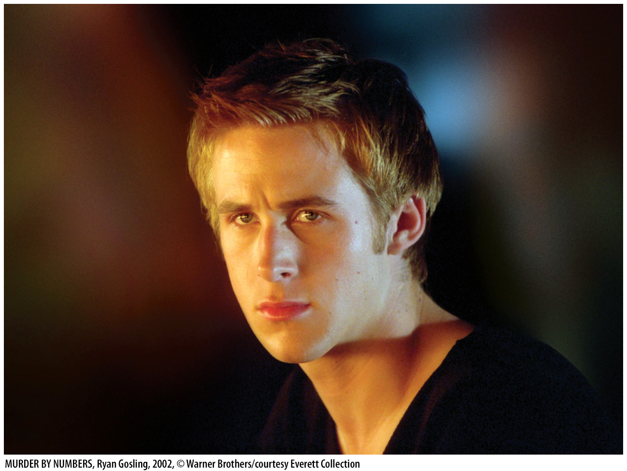
Economics in Murder by Numbers
“Just think of it as a game. Whoever talks first is the winner.”
Notes:
“Economics in the Media” Slide
Lecture tip:
The clip mentioned on the slide can be found in the Interactive Instructor’s Guide. Access the direct link by clicking the icon in the PowerPoint above.
The key concepts covered in this clip are:
Game theory
Prisoner’s dilemma
[MURDER BY NUMBERS, Ryan Gosling, 2002, © Warner Brothers/courtesy Everett Collection]

Slide 29
Game Theory
Dominant strategy
  A best response for a player to choose no matter what the other player chooses
  If each player has a dominant strategy, that makes up a dominant strategy equilibrium.
Nash equilibrium
  Each decision maker is choosing his or her best response to what the other decision maker has chosen.
  A pair of strategies, one for each player, so that neither player will want to unilaterally deviate
Notes:
Lecture notes:
This slide discusses two solution concepts:
Dominant strategy:
A rational player will always choose his or her dominant strategy.
An individual will always want to maximize his or her payoffs (utility).
Note that not all Nash equilibria are dominant strategy equilibria.
For example, every Labrador is a dog, but not every dog is a Labrador.
Unilaterally deviate means that I would want to change my strategy if you don’t.
If I do NOT want to unilaterally deviate, it means that I do NOT want to change (deviate) from my current strategy, given that you don’t change your strategy.

Slide 30
Analyzing the Prisoner’s Dilemma—1
 |  | Tony Montana
 |  | Confess |  | Keep Quiet
Manny Ribera | Confess |  | 10 years in jail |  | 25 years in jail
 |  | 10 years in jail |  | goes free
 | Keep Quiet |  | goes free |  | 1 year in jail
 |  | 25 years in jail |  | 1 year in jail
Notes:
Lecture tip:
This slide, and the following slide, uses the circle method.
Before you click through the slide to show the solution, ask students what they think the players should do.
Then, ask students to take the role of one of the players and figure out what they should do in response to what they believe the other player will do.
Manny:
I believe that Tony will Confess.
If I Confess, I get 10 years in jail.
If I Keep Quiet, I get 25 years in jail.
Therefore, I should Confess.
First click: Circles Manny’s “10 years” payoff.
Manny:
I believe that Tony will Keep Quiet.
If I Confess, I go free.
If I Keep Quiet, I get 1 year in jail.
Therefore, I should Confess.
Second click: Circles Manny’s “Goes Free” payoff.
Now suppose you are Tony:
Tony:
I believe that Manny will Confess.
If I Confess, I get 10 years in jail.
If I Keep Quiet, I get 25 years in jail.
Therefore, I should Confess.
Third click: Circles Tony’s “10 years” payoff.
Tony:
I believe that Manny will Keep Quiet.
If I Confess, I go free.
If I Keep Quiet, I get 1 year in jail.
Therefore, I should Confess.
Fourth click: Circles Tony’s “Goes Free” payoff.

Slide 31
Analyzing the Prisoner’s Dilemma—2
 |  | Tony Montana
 |  | Confess |  | Keep Quiet
Manny Ribera | Confess |  | 10 years in jail |  | 25 years in jail
 |  | 10 years in jail |  | goes free
 | Keep Quiet |  | goes free |  | 1 year in jail
 |  | 25 years in jail |  | 1 year in jail
Dominant strategy equilibrium
Nash equilibrium
Cooperative outcome
Notes:
Lecture notes:
Dominant strategy:
Manny (Tony) always gets less time in jail no matter what Tony (Manny) does.
So {Confess, Confess} is a dominant strategy equilibrium.
Nash equilibrium:
Remember that in a Nash equilibrium, each player chooses his or her best response to what the other player chooses.
The circles represent the players’ best response.
So, in the box where you see two circles, you have a Nash equilibrium.
First click:
Labels the dominant strategy equilibrium and the Nash equilibrium
Ask students why they think cooperation is unlikely.
Second click:
Puts a box around the cooperative solution.
If Tony keep quiet, it’s best for Manny to confess.
If Manny keeps quiet, it’s best for Tony to confess.
Each player has an incentive to rat out the other.

Slide 32
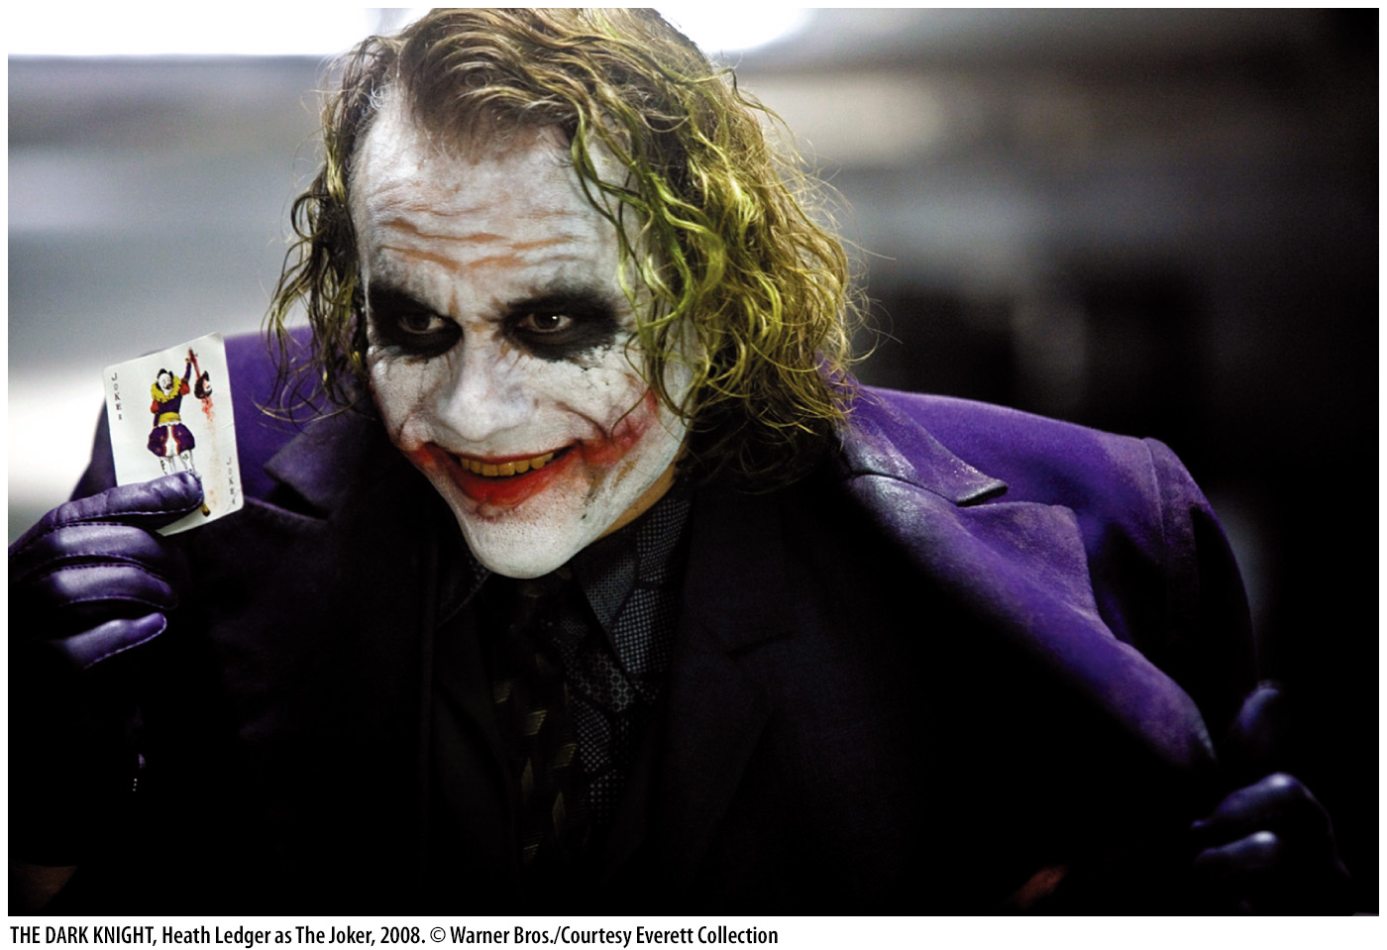
Economics in The Dark Knight
The Joker sets up an ethical experiment that pins two ferries full of passengers against one another.
Notes:
“Economics in the Media” Slide
Lecture tip:
The clip mentioned on the slide can be found in the Interactive Instructor’s Guide. Access the direct link by clicking the icon in the PowerPoint above.
The key concepts covered in this clip are:
Game theory
Prisoner’s dilemma
[THE DARK KNIGHT, Heath Ledger as The Joker, 2008. © Warner Bros./Courtesy Everett Collection]

Slide 33
Economics in Golden Balls
The prisoner’s dilemma often shows up in TV game shows as well.
Notes:
“Economics in the Media” Slide
Lecture tip:
The clip mentioned on the slide can be found in the Interactive Instructor’s Guide. Access the direct link by clicking the icon in the PowerPoint above.
The key concepts covered in this clip are:
Game theory
Dominant strategy
Nash equilibrium

Slide 34
Duopoly and the
Prisoner’s Dilemma
 |  | AT-Phone
 |  | Low |  | High
Horizon | Low |  | $27,000 |  | $30,000
 |  | $27,000 |  | $22,500
 | High |  | $22,500 |  | $24,000
 |  | $30,000 |  | $24,000
Cooperative outcome
Dominant strategy equilibrium
Nash equilibrium
Notes:
Lecture notes:
This slide illustrates the AT-Phone vs. Horizon example used in previous slides. Recall:
Each firm can choose LOW or HIGH production.
LOW = 300 consumers
HIGH = 400 consumers
Go through the solution method in detail once more.
Horizon believes that AT-Phone will go Low.
If Horizon chooses Low, they earn $27,000.
If Horizon chooses High, they earn $30,000.
Therefore, Horizon should produce High output.
First click: Circles Horizon’s “$30,000” payoff.
Horizon believes that AT-Phone will go High.
If Horizon chooses Low, they earn $22,500.
If Horizon chooses High they earn $24,000.
Therefore, Horizon should produce High output.
Second click: Circles Horizon’s “$24,000” payoff.
You can see that Horizon has a dominant strategy (High output). No matter what AT-Phone does, High gives Horizon higher revenue.
Since the game is symmetric, the same logic we just discussed holds for AT-Phone.
Third and fourth click:
Circles AT-Phones best responses.
Fifth click:
Labels dominant strategy equilibrium and Nash equilibrium.
Sixth click:
Labels cooperative outcome.
Finally, point out again why collusion is unstable.

Slide 35
Advertising and the
Prisoner’s Dilemma
 |  | Coca-Cola
 |  | Advertises |  | Does Not Advertise
PepsiCo | Advertises |  | $100 M |  | $75 M
 |  | $100 M |  | $150 M
 | Does Not Advertise |  | $150 M |  | $125 M
 |  | $75 M |  | $125 M
Nash equilibrium
Cooperative outcome
Notes:
Lecture notes:
This is another duopoly firm game. In this example, PepsiCo and Coca-Cola can choose: Advertise or Does Not Advertise.
Ask students to go through the circle solution method and find the solution. By now they should have it.
Start with PepsiCo.
First click:
Circles: $100 million at {Advertise, Advertise}
Second click:
Circles: $150 million at {Advertise, Does Not Advertise}
Then go through Coca-Cola.
Third click:
Circles: $100 million at {Advertise, Advertise}
Fourth click:
Circles: $150 million at {Does Not Advertise, Advertise}
Note that Advertise is a dominant strategy for each firm.
Fifth click:
Labels Nash equilibrium.
Sixth click:
Labels cooperative outcome.
Both firms would be better off by not advertising. But if one firm does not advertise, the best response of the other firm is to advertise.

Slide 36
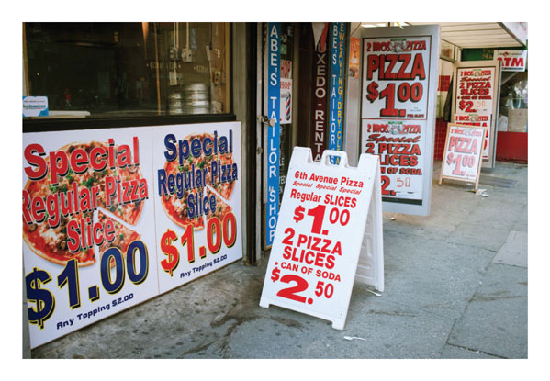
Intuition of Advertising
Prisoner’s Dilemma
Advertising
  If both firms advertise, costs go up, but each firm’s campaign cancels out the other.
  Both firms would be better off NOT advertising.
  But, if one firm agrees to
  not advertise, the other
  firm would.
Notes:
Lecture notes:
In the picture on the slide, two firms are advertising right next to each other.
This type of advertising is pretty cheap, but most advertising (TV, radio, Internet) can get very expensive.
[© Richard Levine / Alamy]

Slide 37
An Effort Dilemma
 |  | Mary
 |  | Work |  | Shirk
Paul | Work |  | 100 |  | 150
 |  | 100 |  | 20
 | Shirk |  | 20 |  | 50
 |  | 150 |  | 50
Cooperative outcome
Nash equilibrium
Notes:
Lecture notes:
This is another example to illustrate the Prisoner’s Dilemma.
Suppose Paul and Mary are two students who must work together on a research paper.
They can choose to either Work or Shirk.
Working is beneficial since they will get a higher grade on the research paper. But working is costly. Paul and Mary have more fun things to do than work on a research paper.
Note that the payoffs in the matrix are measured in utils—happy points. The more utils, the better off you are.
Also note that:
The best outcome for a player is to Shirk if the other player Works.
That way they get a “decent” grade but don’t work.
The second-best outcome is if both player’s Work.
You get the highest possible grade on the paper.
The third-best outcome is if they both Shirk.
They get a low grade on the research paper but don’t work.
The worst outcome for a player is if he or she Works if the other player Shirks.
Be prepared for some students to disagree with the ranking of the different outcomes.
Does Paul have a dominant strategy?
First click:
Circles Paul’s payoffs.
Does Mary have a dominant strategy?
Second click:
Circles Mary’s payoffs.
What is the Nash equilibrium?
Third click:
Labels {Shirk, Shirk}
What “should” Paul and Mary do?
Fourth click:
Labels cooperative outcome
What they “should” do appears to be inconsistent with what rational utility maximizing individuals would do.

Slide 38
Class Activity: Think-Pair-Share: Prisoner’s Dilemma in Everyday Life
Discuss why the following three scenarios are examples of the prisoner’s dilemma. Can you come up with your own examples?
People standing at concerts, even though they can see just as well when everyone else sits
People shouting at parties
Leaving a tip at an out-of-town restaurant
Notes:
Classroom activity: Think-Pair-Share: The Prisoner’s Dilemma in Everyday Life (See Tip #471)
Ask students to discuss the three scenarios above and then come up with their own examples.

Slide 39
Escaping the Prisoner’s Dilemma
The prisoner’s dilemma captures the idea that cooperation is unstable.
But firms do collude, and people do cooperate, so what’s wrong with our analysis?
  It’s only played once. Most interactions occur over the long run.
  Players play a repeated game.
  Compare the short-run gains from cheating to the long-run losses you would suffer if cooperation breaks down.
Notes:
Lecture tip:
Point out that we may not want firms or prisoners cooperating, but we do want Paul and Mary (from the previous example, on Slide 37) cooperating.
Think of the prisoner’s dilemma as a metaphor for the “game of life.” We play prisoner’s dilemma–type games all the time, yet we have managed to find ways to maintain cooperation.
In repeated games, strategies get complex. They must specify what you should do in the first round of the game and what you should do in future rounds contingent on past play.
Chess is a nice example to illustrate the complexity of strategies.
On Black’s first move, it would have 400 possible strategies: 20 possible moves to each of White’s 20 possible opening moves.
Assuming a typical game of chess takes 40 moves per player, the number of possible strategies in chess is roughly 10¹²⁰. Assuming that it would take one second to check every possible move, it would take about three x 10¹¹² years to play a typical game of chess.

Slide 40
Escaping the Prisoner’s Dilemma in the Long Run
Axelrod Tournament
Which strategy won?
Tit-for-Tat:
  Strategy that promotes cooperation among players mimicking the opponent’s most recent decision with repayment in kind.
  Why do you think it sustains cooperation?
Notes:
Lecture notes:
Axelrod Tournament:
It invited large number of people to submit different strategies for a repeated prisoner’s dilemma.
These strategies were then randomly matched against other strategies and total payoffs calculated.
The weakest strategy was eliminated, and the simulation was rerun.
The strategy that performed best was Tit-for-Tat.
Why does Tit-for-Tat work?
You could answer this question by comparing it to the Grim Strategy.
In this case, once a player has cheated, you never cooperate again.
Tit-for-Tat is forgiving. It punishes a cheater, but as long as he or she has gone back to cooperation after cheating, you punish him or her once and go back to cooperation.

Slide 41
Economics in L.A. Confidential
A twist on the prisoner’s dilemma
Notes:
“Economics in the Media” Slide
Lecture tip:
The clip mentioned on the slide can be found in the Interactive Instructor’s Guide. Access the direct link by clicking the icon in the PowerPoint above.
This clip provides an example of a sequential prisoner’s dilemma. The other key concepts covered in this clip are:
Backward induction
Game theory

Slide 42
Sequential Games—1
What if players take turns rather than moving at the same time?
Backward induction
  The process of deducing backward from the end of a scenario to infer a sequence of optimal actions
Notes:
Lecture notes:
An example you can provide is:
A potential entrant decides to enter or not.
Then, the incumbent firm decides whether to engage in a price war or to accommodate entry.
Backward induction (some call it rollback) is the method to solve sequential games.

Slide 43
Cooperate or Not
 |  | Iggy
 |  | Agree |  | Disagree
Azalea | Agree |  | $20,000 |  | $75,000
 |  | $60,000 |  | $50,000
 | Disagree |  | $50,000 |  | $25,000
 |  | $35,000 |  | $75,000
Notes:
Lecture notes:
Before clicking through the slide to reveal the circles, ask students to find the players’ dominant strategy.
There is no dominant strategy.
Then, ask students to find the Nash equilibrium.
First and second clicks:
Circles appear.
There is no Nash equilibrium (at least in pure strategies).
Lecture tip: In an introductory course, it probably isn’t useful to go into mixed strategies.

Slide 44
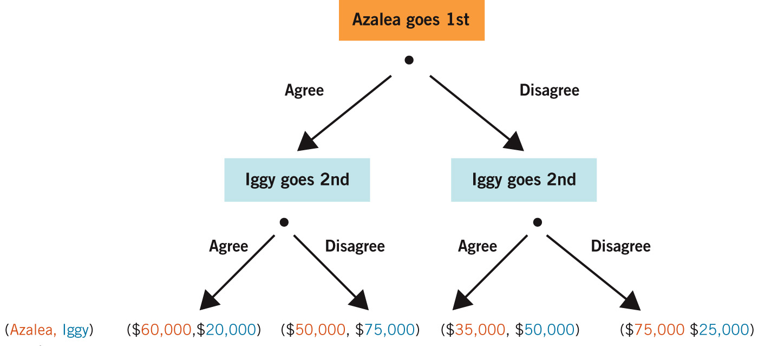
Sequential Games—2
Notes:
Image: Animated Figure 13.5
Lecture notes:
The figure on the slide is called a decision tree.
It illustrates all of the possible outcomes in a sequential game.
Azalea moves first and can choose to Agree or Disagree.
Iggy observes her choice and can then choose to Agree or Disagree.
The payoffs are listed at the bottom; the first number is Azalea’s.
To solve the game, we have to start at the last person to make a decision: Iggy.
Suppose Azalea has chosen to Agree. Iggy is making a decision at the left bottom node.
If he Agrees, he gets $20,000. If he Disagrees, he gets $75,000.
Therefore, he will Disagree.
Make sure students look at the BLUE payoffs.
First click:
Crosses off the Agree branch.
Suppose Azalea has chosen to Disagree. Iggy is making a decision at the right bottom node.
If he Agrees, he gets $50,000.
If he Disagrees, he gets $25,000.
Therefore, he will Agree.
Second click:
Crosses off the Disagree branch.
Now go to the node where Azalea makes a decision. She “sees” what will happen in the tree. She looks at the RED payoff numbers.
If she Agrees, she knows Iggy will Disagree, and she will get $50,000.
If she Disagrees, she knows Iggy will Agree, and she will get $35,000.
Therefore, Azalea will Agree.
Third click:
Crosses off Disagree branch.
So the solution to the game is for Azalea to Agree and Iggy to Disagree. Azalea gets $50,000 and Iggy gets $75,000.

Slide 45
Game Theory: Some Extensions
So far all the games we’ve seen had a dominant strategy.
We also saw that if both players have a dominant strategy, that outcome is a Nash equilibrium.
In many games, neither player has a dominant strategy.
And in some games, there is either no Nash equilibrium or multiple Nash equilibria.
Notes:
Lecture notes:
On the last point on the slide:
This should really be, “There are no Nash equilibrium in pure strategies.”
There is always a Nash equilibrium in mixed strategies.

Slide 46
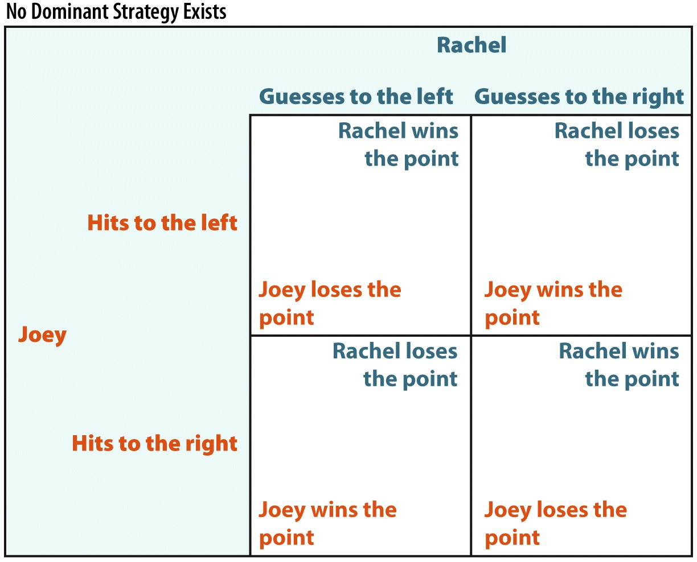
No Dominant Strategy or Nash Equilibrium: Racquetball
Notes:
Lecture notes:
Joey and Rachel are playing racquetball. Joey can Hit to the Left or Hit to the Right. Rachel can Guess Left or Guess Right.
Note that this particular game is zero-sum.
One person’s win is equal to the other person’s loss.
Rachel’s strategies could also be Go Left and Go Right.
We treat this as a simultaneous game since Rachel has to react as Joey is hitting the ball.
Basically, Joey’s and Rachel’s best responses are different depending on what the opponent does:
If Joey believes Rachel will Guess Left, he will Hit Right.
But, if Joey believes Rachel will Guess Right, he will Hit Left.
If Rachel believes Joey will Hit Left, she will Guess Left.
If Rachel believes Joey will Hit Right, she will Guess Right.
Neither player has a dominant strategy.
Also, at all outcomes, one player would always want to change his or her strategy, holding the strategy of the other player fixed.
There is no pure strategy Nash equilibrium in this game as well.

Slide 47
Multiple Nash Equilibria: Battle of the Sexes
 |  | Juliet
 |  | Rest X |  | Rest Y
Romeo | Rest X |  | 2nd Best |  | Third Best
 |  | Best |  | Third Best
 | Rest Y |  | Worst |  | Best
 |  | Worst |  | 2nd Best
Notes:
Lecture notes:
This is another “toy game” that students enjoy.
The players in the game are Romeo and Juliet, but you could use two students in your class.
You would want to change the names of the restaurants to reflect your city.
The story is:
Romeo and Juliet are dating and are madly in love.
In the morning, they decided they would meet for dinner after they finish their last class of the day.
The classes are on different parts of campus, so they drive to the restaurant separately.
Unfortunately, on this particular night, they both have forgotten at which restaurant they are supposed to meet. And their cell phones are dead so they can’t call each other.
Therefore, they each must decide which restaurant to go to based on their belief of where the other will go.
Preferences:
Romeo prefers X over Y, and Juliet prefers Y over X.
But they are in love, so each would prefer to be together at the restaurant he or she likes least rather than alone at the restaurant he or she prefers.
Go over the four outcomes: Best to Worst. Then, ask students to find the solution.
First click:
Adds the circles.
Note that there are now two Nash equilibria: {X, Y} and {Y, X}.
In game theory, we now have an equilibrium selection problem. Both are equilibria in the sense that once at that outcome, neither player has an incentive to change his or her action.
Finally, ask students which outcome they think is likely to be the one chosen and why. This usually leads to an interesting class discussion.
What we are talking about is a focal point: Is there something behind the game that makes one equilibrium outcome more attractive than the other?
What is focal could depend on culture, history, and so on.
For example, if you are a “good” Romeo, you should sacrifice your preferences to satisfy Juliet and go to Y. Juliet, knowing this is the norm, would then also go to Y.
An anomaly: (Note from the PowerPoint author)
Where I teach, there is a much larger number of women than men, and it has an effect when male and female students play the game. Males are much more likely to choose the restaurant they like. Women, knowing this, choose the male’s preferred restaurant.

Slide 48
Practice What You Know—3
How can a pure strategy Nash equilibrium be accurately described?
  It is always the overall best outcome.
  It’s an outcome in which neither player wants to change strategies.
  It can only be reached by collusion.
  One exists in all games.
Notes:
Clicker question:
Correct answer: B, It’s an outcome in which neither player wants to change strategies.
Just by definition, the Nash equilibrium is where no player wants to change strategies given that the other player isn’t changing his or her strategy.
In other words, nobody wants to unilaterally deviate.
Not all games have a pure strategy Nash equilibrium.
Rock, Paper, Scissors is an example of a game without an equilibrium.

Slide 49
Practice What You Know—4
Based on the table below, which outcome reflects the dominant strategy?
  top left
  top right
  bottom left
  bottom right
 |  | University Subs
 |  | 2-for-1 |  | Keep Prices High
Savory Sandwiches | 2-for-1 |  | $1,000 |  | - $5,000
 |  | $1,000 |  | $15,000
 | Keeps Prices High |  | $15,000 |  | $10,000
 |  | - $5,000 |  | $10,000
Notes:
Clicker question:
Correct answer: A, top left
If University Subs chooses 2-for-1, Savory’s best response is to choose 2-for-1 as well, since $1,000 > -$5,000.
If University Subs chooses Keep Prices High, Savory’s best response is to choose 2-for-1, since $15,000 > -$5,000.
Therefore, Savory’s dominant strategy is to choose 2-for-1.
The game is symmetric, so University Subs’s dominant strategy is also 2-for-1.

Slide 50
Economics in The Informant
How do government policies affect oligopoly behavior?
Notes:
“Economics in the Media” Slide
Lecture tip:
The clip mentioned on the slide can be found in the Interactive Instructor’s Guide. Access the direct link by clicking the icon in the PowerPoint above.
This clip illustrates a meeting to formulate an agreement to reduce industry output, allocate output shares among firms, and raise prices. It therefore provides a good example of the following key concepts:
Collusion
Antitrust laws
Pricing

Slide 51
Government Policies and
Oligopoly Behavior—1
Antitrust policy
  Government efforts that attempt to prevent oligopolies from behaving like monopolies
Sherman Act of 1890
  “Every person who shall monopolize, or attempt to monopolize, or combine or conspire with any other person or persons, to monopolize any part of the trade or commerce among the several States, or with foreign nations, shall be deemed guilty of a felony.”
Notes:
Lecture notes:
Sherman Antitrust Act:
It was created in response to the increase in the concentration ratios in many leading U.S. industries, including steel, railroads, mining, textiles, and oil.
Prior to the passage of the Sherman Act, firms were free to pursue contracts that created mutually beneficial outcomes.
The quote on the slide is Section 2 of the Sherman Act.
You could discuss how the Sherman Act did not specifically prohibit monopoly.

Slide 52
Government Policies and
Oligopoly Behavior—2
Clayton Act (1914)
  Price discrimination that lessens competition
  Exclusive dealings that restrict the ability of a buyer to deal with competitors
  Tying arrangements (similar to bundling)
  Mergers that lessen competition
  Prevents a person from serving as a director on more than one board in the same industry
Notes:
Lecture notes:
One of the problems with the Sherman Act was that the only conduct that was made illegal was collusion. Monopolization was illegal, but it was unclear what behavior should be viewed as anti-competitive.
The Clayton Act targeted specific corporate behaviors that reduce competition.
Over time, other acts were passed strengthening antitrust law. For example:
Robinson-Patman Act (1936)
Prohibits special discounts and other discriminatory concessions to large purchasers unless based on differences in cost to meet the price of a competitor
Celler-Kefauver Act (1950)
Prohibited a corporation from buying the assets of another firm where the effect is to reduce competition substantially or to tend to create a monopoly
Passed to prevent the negative effects of conglomerate mergers

Slide 53
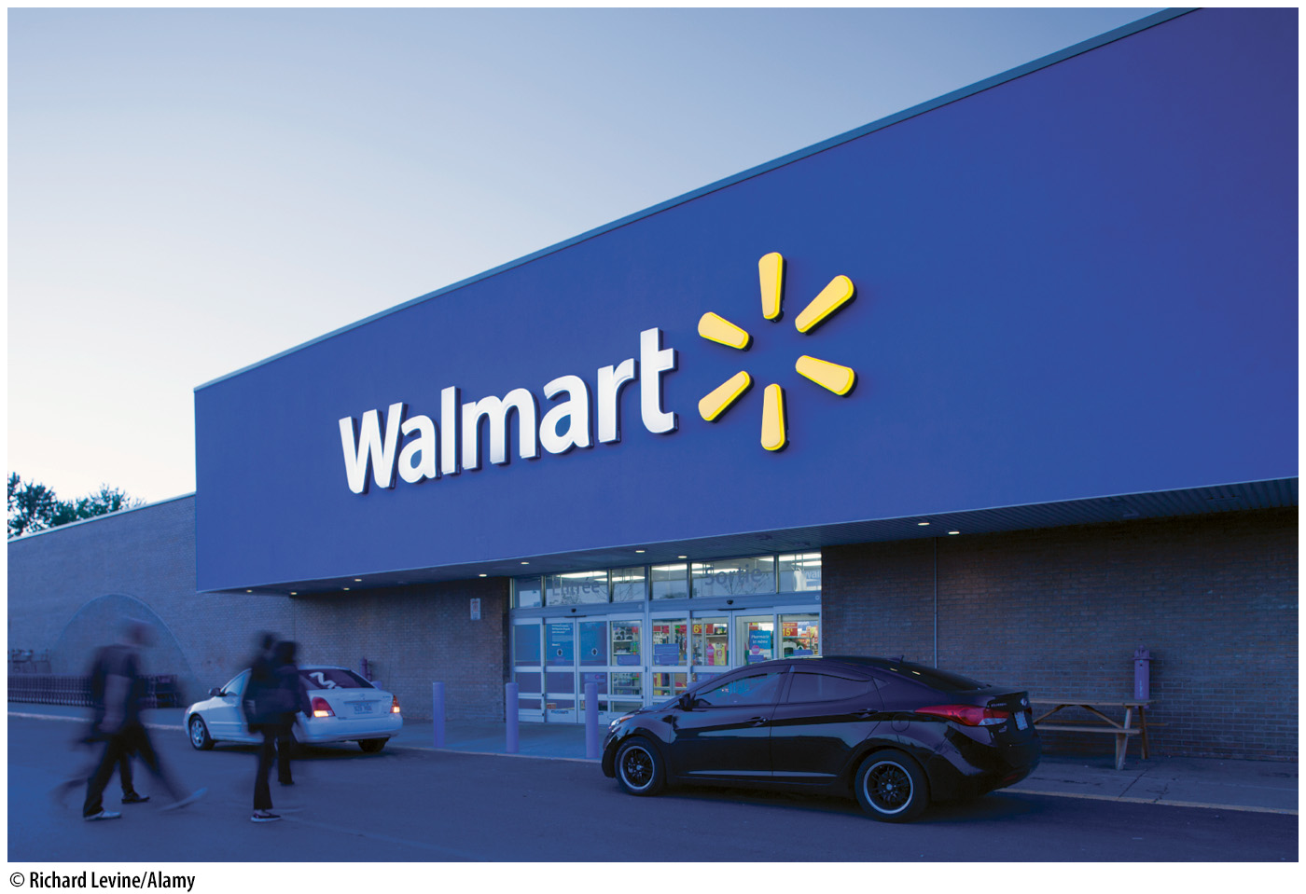
Predatory Pricing
Predatory pricing
  Firm sets price below AVC with the intent of driving rivals from the market
  How do you distinguish between predatory pricing and intense market competition?
Examples:
  Wal-Mart
  Microsoft
Notes:
Lecture notes:
P < AVC (MC) is known as the Areeda-Turner Rule.
From a court’s perspective, charging a price < average cost was per-se illegal, since no rational firm would sell its good at a loss, unless the intent was to drive out rivals.
More recent cases also consider whether a firm accused of predatory pricing could reasonably be able to recoup their losses once their rival is driven from the market.

Slide 54
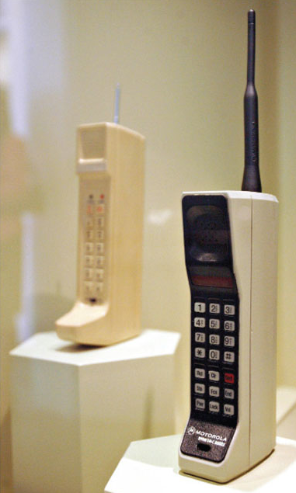
Network Externalities—1
Network externality
  Occurs when the number of customers who purchase a good influences the quantity demanded
  Classic examples:
    Cell phones and fax machines
  Make it easier for firms to attract new
  customers and keep customers from
  switching to a rival
  Importance of critical mass
Notes:
Lecture notes:
Some examples of network externalities can include:
MySpace and Facebook
Facebook came to dominate since they built a better social network, and MySpace was slow to respond to the threat.
Computer applications
Microsoft’s Office suite
Critical mass:
In the case of technologies, firms need to reach a critical mass before consumers can effectively use them.
Tipping point: how many users have to switch to a new technology before it becomes the dominant one.
[Tim Boyle/Bloomberg/Getty Images]

Slide 55

Network Externalities—2
Switching costs
  Costs that are incurred by a consumer when he or she switches suppliers
  Demand for the existing product becomes more inelastic if switching costs are high.
  Cell Phone Providers
    Early termination fees, free in-network calls
Notes:
Lecture notes:
Examples of switching costs:
From music on CDs to using digital music files
This involved substantial switching cost.
From MP3s or iTunes to newer formats
Airlines: Frequent flier benefits
Credit cards: Reward programs
FTC reduced switching costs in 2003 by requiring phone companies to allow consumers to take their old phone number to a new provider.
[© STANCA SANDA/Alamy Stock Photo]

Slide 56
Network Externalities—3
How does this relate to oligopoly and market power?
  The stronger the externality effect, the more market power a firm will have.
  First firm into a market grows quickly and captures a large number of consumers
  Makes it difficult for smaller rivals to gain market share, or forces them out of the market
Notes:
Lecture notes:
When a positive externality exists, firms with many customers often find it easier to attract new customers and to keep their regular customers from switching to other rivals.
High switching costs reinforce this effect, since they make it harder for customers to switch to another network.
Again, we have to think about tradeoffs: the costs consumers face if firms have more market power compared to the benefits to consumers of the network effects.

Slide 57
Practice What You Know—5
What is an example of a good with a positive network effect?
  an online multiplayer game
  a fast-food burger
  a dry-cleaning service
  a cable TV subscription
Notes:
Clicker question:
Correct answer: A, an online multiplayer game
Online gaming may have a higher demand if you can play with more people (a larger network).

Slide 58
Practice What You Know—6
Which of the following is most likely to become an oligopoly industry?
  an industry without entry barriers
  an industry where economies of scale are very small
  an industry with sizeable network effects
  an industry with hundreds of competitors
Notes:
Clicker question:
Correct answer: C, an industry with sizeable network effects
Noticeable network effects mean that there is only room for a small number of large networks. Oligopoly will develop after networks that are “too small” either go out of business or merge with other networks.

Slide 59
Price Taking | Price Making
Perfect Competition | Monopolistic Competition | Oligopoly | Monopoly
1. Many firms | 1. Many firms | 1. Few firms | 1. One firm
2. Atomistic assumption—firms are so small that no single buyer or seller has ANY control over price | 2. Each firm has some control over price | 2. Medium-to-high entry barriers to entry; the firm has more control over price | 2. Extremely high barriers to entry; the firm has significant control over price
3. Firms are so small that no single buyer or seller has ANY control over price | 3. Product differentiation | 3. Mutual interdependence | 3. The firm IS the industry
4 Homogeneous output | 4. Easy entry/exit | 4. Long-run economic profit possible | 4. Long-run economic profit probable
5. There is perfect information about product price and quantity |  | 5. Output can be homogenous or differentiated
6. Easy entry/exit
Notes:
Lecture tip:
This slide is a concise but informative review of the characteristics of all four market structures.

Slide 60
Conclusion
Oligopoly
  A market structure in which there are a small number of firms
  Firms interact strategically
  Can be competitive (results closer to monopolistic competition)
  Can be collusive (results closer to monopoly)
Antitrust policies
  Restrain excessive market power
  Give incentives to compete instead of collude
  Each industry examined on a case-by-case basis
Notes:
Lecture notes:
To recap some of the points made in this chapter:
An oligopoly:
Small number of firms that sell a differentiated product in a market with significant barriers to entry
The small number of sellers in an oligopoly leads to mutual interdependence.
Oligopolists may collude in an attempt to share profits.
Collusion tends to be unstable, since firms have an incentive to cheat on the agreement.
Oligopolistic markets are socially inefficient, since P > MC.
Game theory is a tool economists use to understand oligopoly behavior.
Dominant strategies and Nash equilibrium
Although cooperation is jointly beneficial, each player had an incentive to break the agreement.
With repeated interaction, cooperation is likely to be sustained.
Antitrust laws are complex and cases are hard to prosecute, but they provide firms an incentive to compete rather than collude.
The presence of significant positive network externalities causes small firms to be driven out of business or to merge with larger competitors.

